Slide 1
Computer Vision & Pattern Recognition
计算机视觉与模式识别概述
张长青
天津大学 智能与计算学部

Slide 2
考核与评价
平时成绩占20%：作业、课堂。
阅读文献：至少1篇计算机视觉相关文献，并总结其主要创新与不足，进行改进展望；【1页word】
实验作业
实验与课程设计：80%
改进一个经典工作：结合阅读文献（最好基于文献阅读），实现一个微型视觉功能Demo：标明自己的思考和改进之处。
3-5页PPT，强调改进之处

Slide 3
主要内容
引子
什么是计算机视觉？
计算机视觉可以做什么？
当前计算机视觉热点是什么？
计算机视觉的主要挑战是什么？

Slide 4
引子： 先直观感受一下计算机视觉

Slide 5
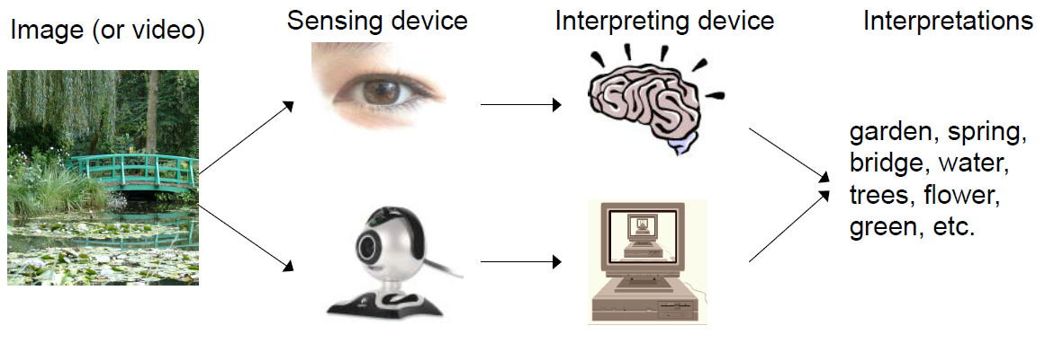
人类视觉 VS 机器视觉
Pipeline of computer vision
感知->理解->决策

Slide 6
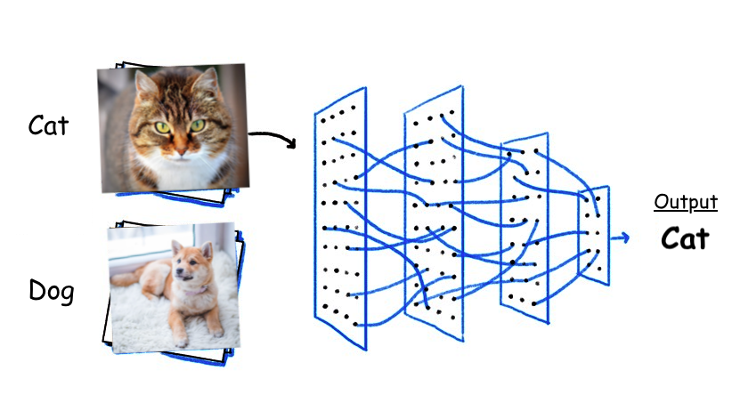
图像分类
万变不离其宗：y = f (x)

Slide 7
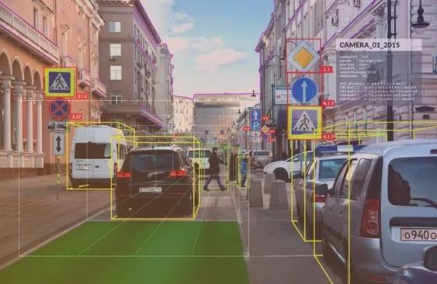
目标检测、识别

Slide 8
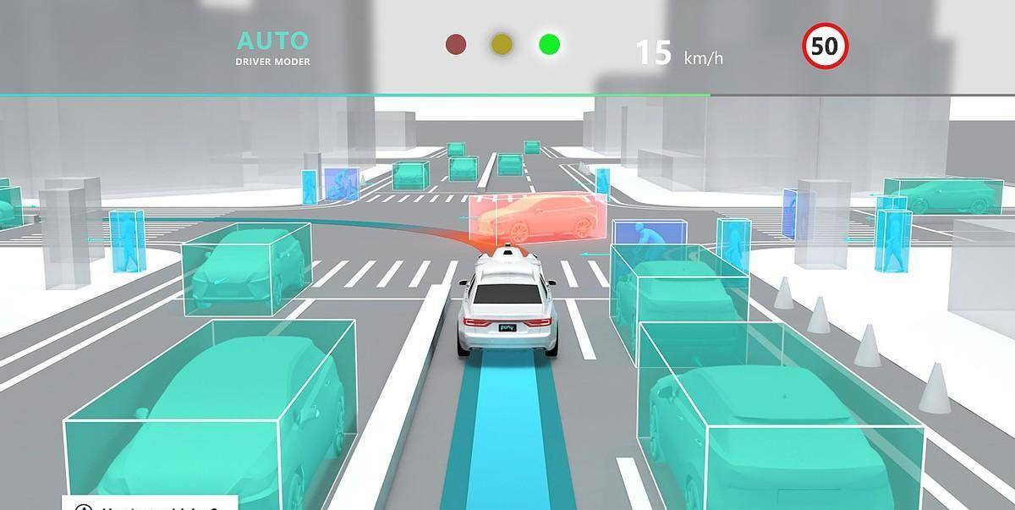
目标检测、识别

Slide 9
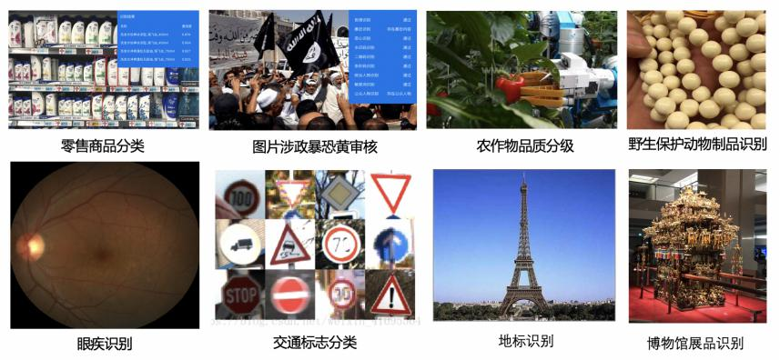
视觉应用

Slide 10
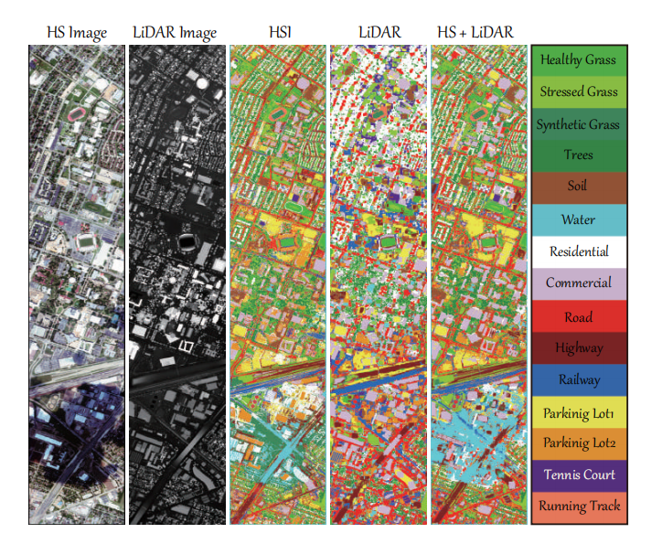
遥感图像

Slide 11
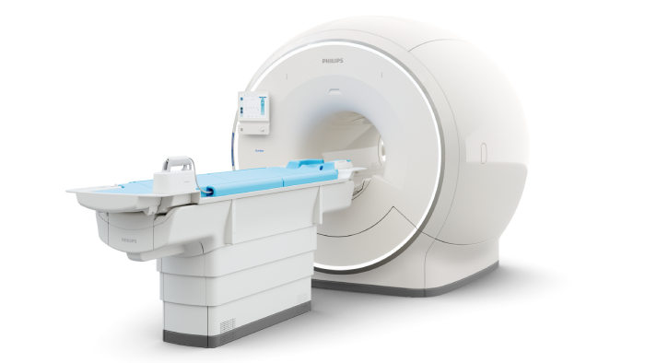
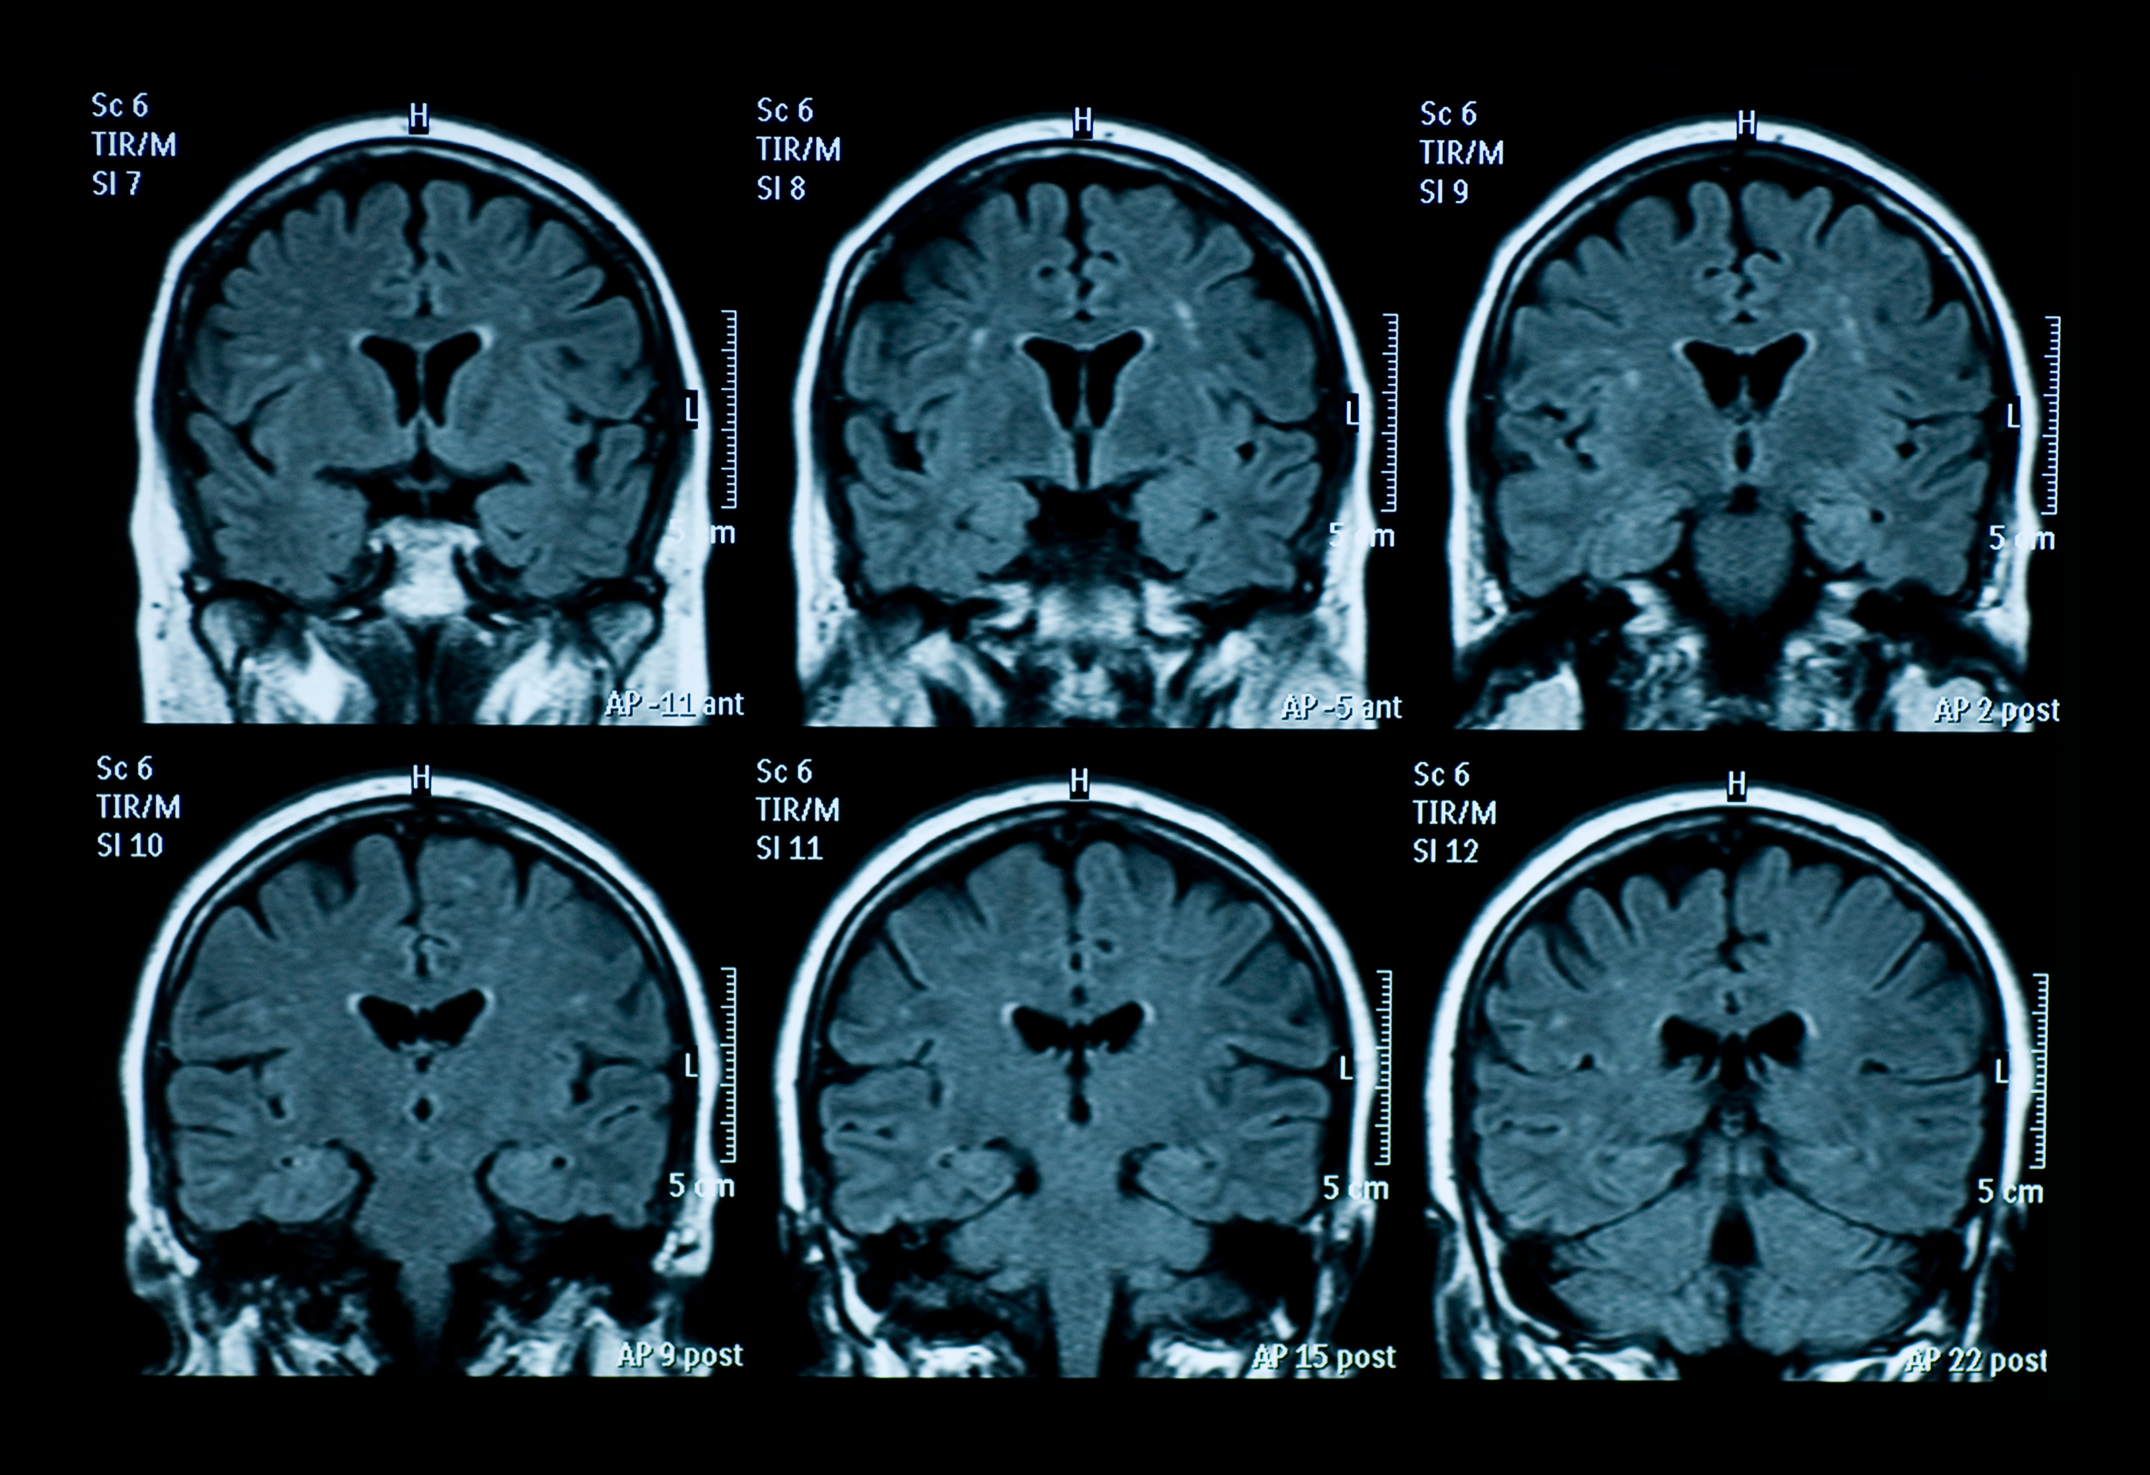
医学图像

Slide 12
什么是计算机视觉？

Slide 13

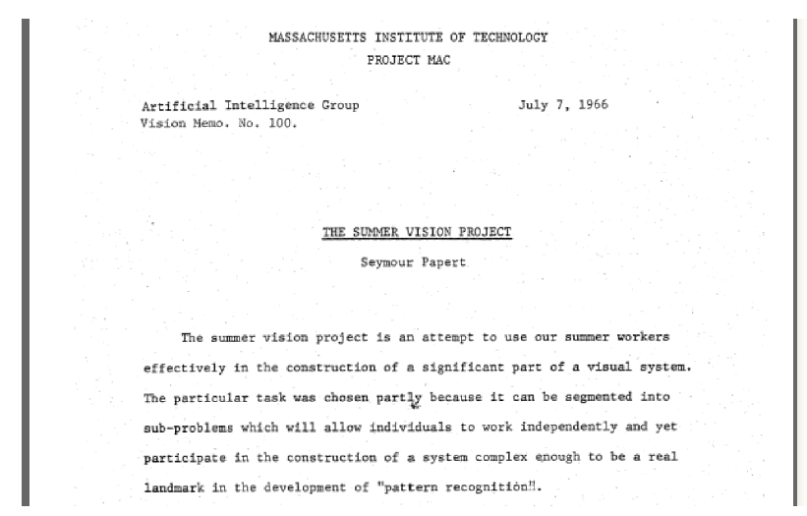
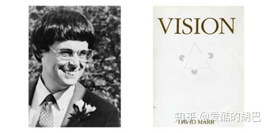
What is computer vision?
Origins of computer vision
(起源)
MIT undergraduate summer project (1966)
Notes:
现代计算机视觉的开端是在1966年的一个夏天，MIT人工智能实验室成立了，在60年代，世界上有两个具有前瞻性的人工智能实验室成立，一个在麻省理工，一个在斯坦福，这两个大学绝对是世界上最好的两所大学之一了，人才数不胜数，现代他俩依然是非常厉害的人工智能实验室，包括我们所熟知的李飞飞，安德鲁都在这两个实验室。那么咱们接着讲，就是1966年的那个夏天，MIT的教授准备着手解决视觉问题，他想视觉很简单啊，咱们一个夏天解决它吧，于是成立了夏季暑假工实习，想要一个暑假搞定视觉问题。但是，显然没解决，不过还是产生了很多非常有意义的成果的。

Slide 14
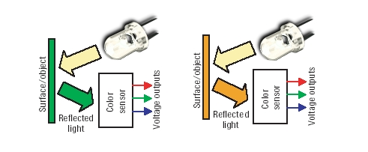
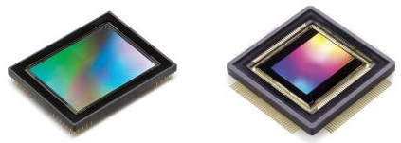
What is computer vision?
RGB 传感器

Slide 15
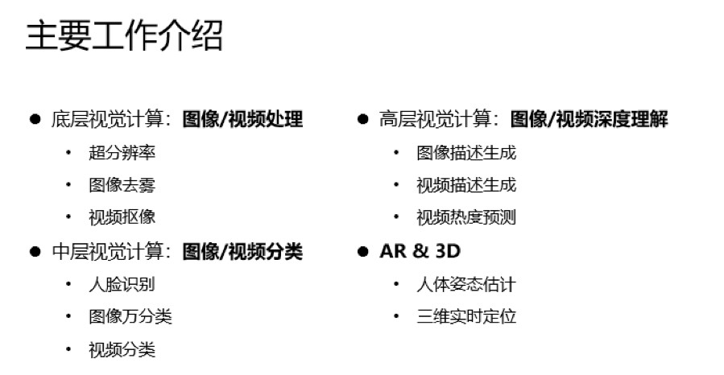
What is computer vision?

Slide 16
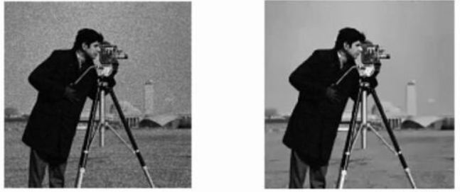
What is computer vision?
底层图像处理
《IEEE Transactions on Image Processing》
Notes:
传感器的质量、成像时候的环境因素等造成图像质量不理想：如何去除噪声呢？Low-rank思想是一条路径

Slide 17
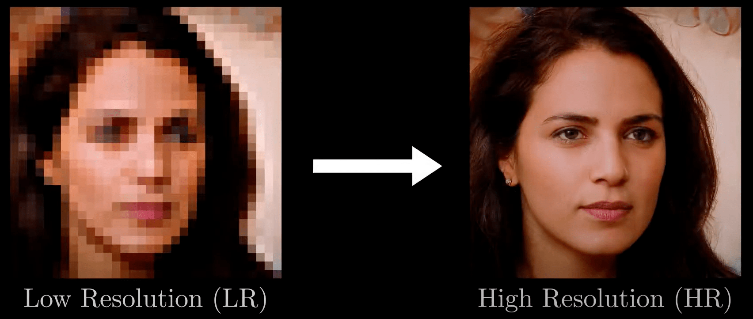
What is computer vision?
底层图像处理
《IEEE Transactions on Image Processing》
Notes:
传感器的质量、成像时候的环境因素等造成图像质量不理想

Slide 18
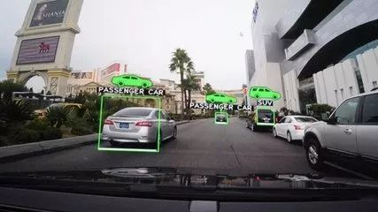
What is computer vision?
中层图像处理：目标检测、识别
《Pattern Recognition》《IEEE Transactions on PAMI》

Slide 19
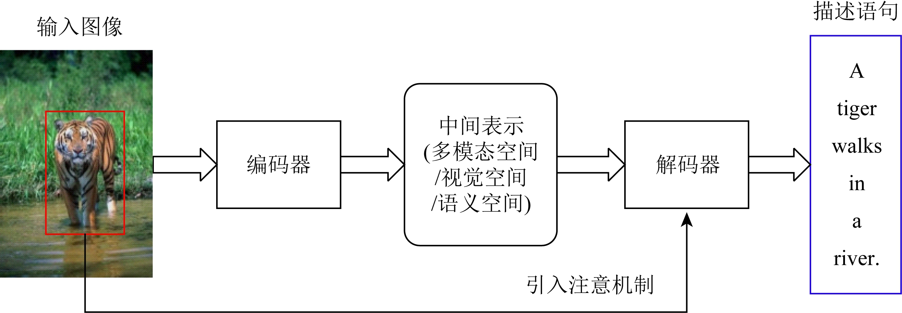
What is computer vision?
高层视觉：图像语义描述生成
Li Zhixin, Wei Haiyang, Zhang Canlong, Ma Huifang, Shi Zhongzhi. Research Progress on Image Captioning[J]. Journal of Computer Research and Development, 2021

Slide 20
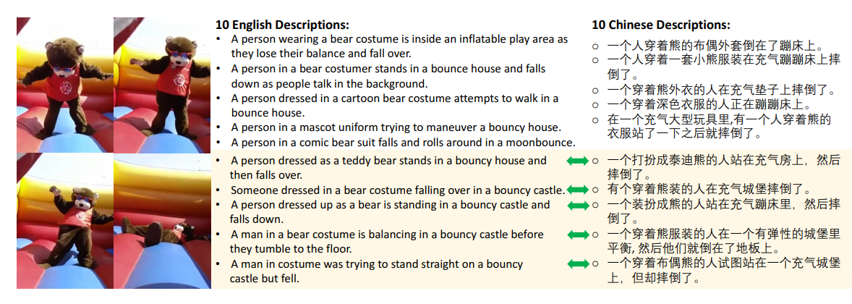
What is computer vision?
高层视觉：视频语义描述生成
VATEX: A Large-Scale, High-Quality Multilingual Dataset for Video-and-Language Research. https://arxiv.org/pdf/1904.03493v2

Slide 21
What is computer vision?
计算机视觉（Computer vision）是人工智能 (AI) 的一个领域，是指让计算机和系统能够从图像、视频和其他视觉输入中获取有意义的信息，并根据该信息采取行动或提供建议。 如果说人工智能赋予计算机思考的能力，那么计算机视觉就是赋予发现、观察和理解的能力。

Slide 22
What is computer vision?
图像获取：一幅数字图像是由一个或多个图像传感器产生。这里的传感器可以是各种光敏摄像机，包括遥感设备，X射线断层摄影仪，雷达，超声波接收器等。取决于不同的传感器，产生的图片可以是普通的二维图像，三维图组或者一个图像序列。图片的像素值往往对应于光在一个或多个光谱段上的强度（灰度图或彩色图），但也可以是相关的各种物理数据，如声波，电磁波或核磁共振的深度，吸收度或反射度。

Slide 23
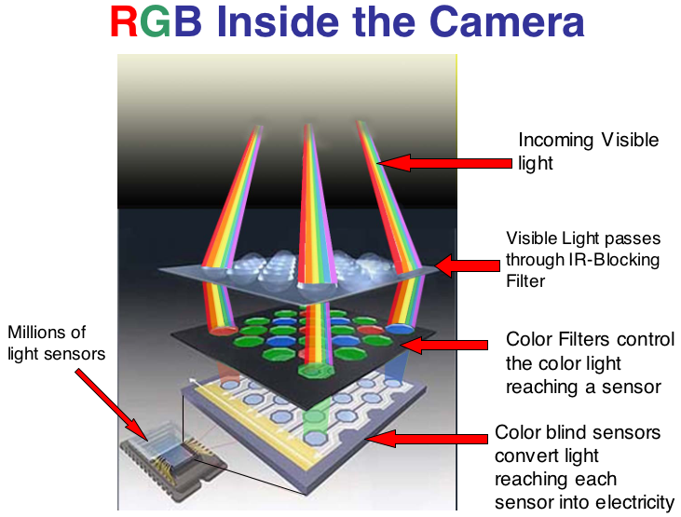
http://www.photoaxe.com/wp-content/uploads/2007/04/camera-sensor.jpg

Slide 24
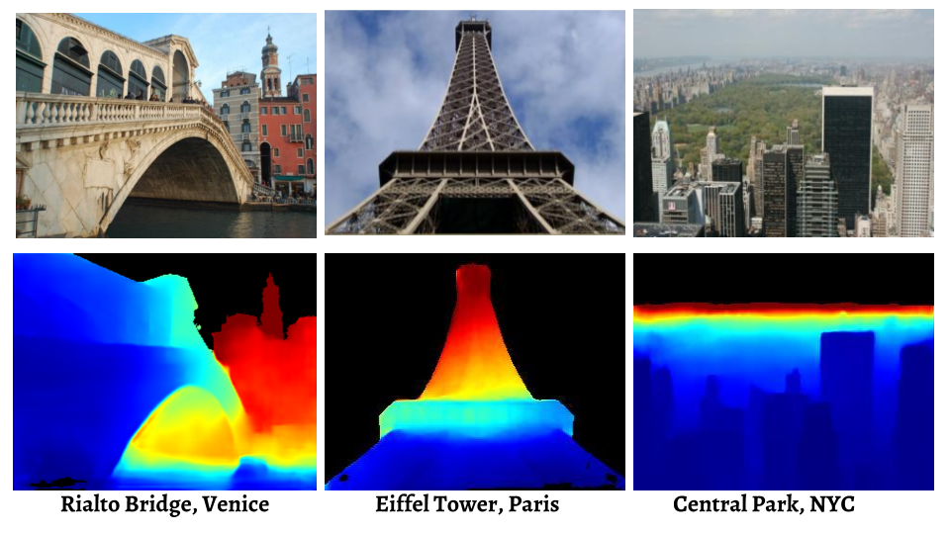
What is computer vision?

Slide 25
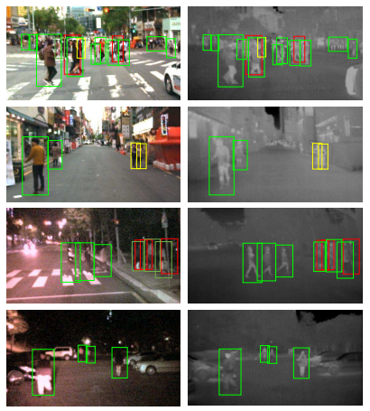
What is computer vision?
夜晚环境下可见光信息缺失
红外图像在采集时存在噪声
环境多变且目标密集
目标尺度大小变化较大

Slide 26
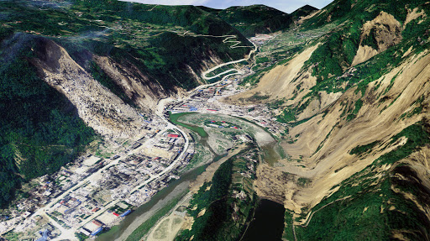
What is computer vision?

Slide 27
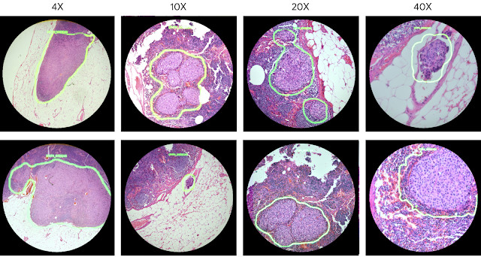
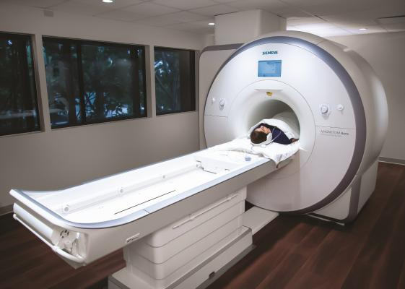
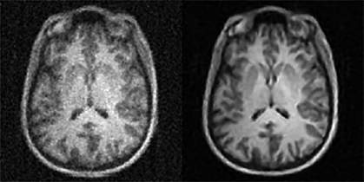
What is computer vision?

Slide 28
What is computer vision?
预处理：在对图像实施具体的计算机视觉方法来提取某种特定的信息前（图像识别），一种或一些预处理往往被采用来使图像满足后继方法的要求。
平滑去噪来滤除传感器引入的设备噪声
提高对比度来保证实现相关信息可以被检测到
去噪之后是否真的对识别任务有帮助？

Slide 29
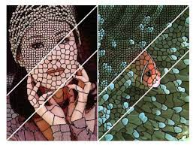
用于跟踪，超像素词袋，医学图像分割等对分割的速度有要求的应用。
超像素由一系列位置相邻且颜色、亮度、纹理等特征相似的像素点组成的小区域。这些小区域大多保留了进一步进行图像分割的有效信息，且一般不会破坏图像中物体的边界信息，用少量的超像素代替大量像素表达图像特征，降低了图像处理的复杂度，一般作为分割算法的预处理步骤。

Slide 30
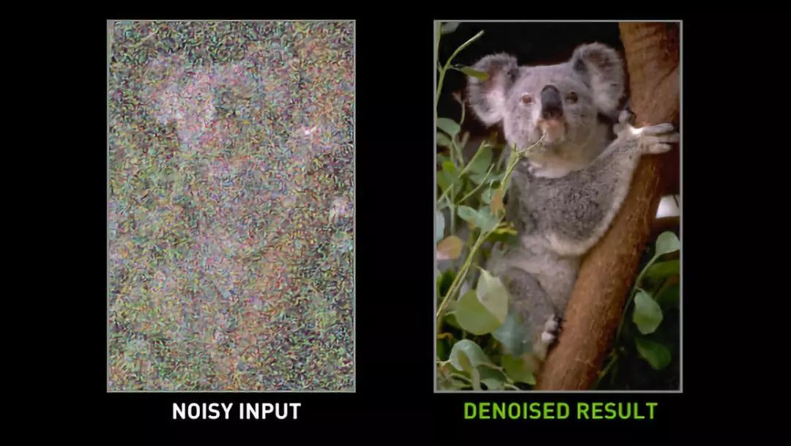
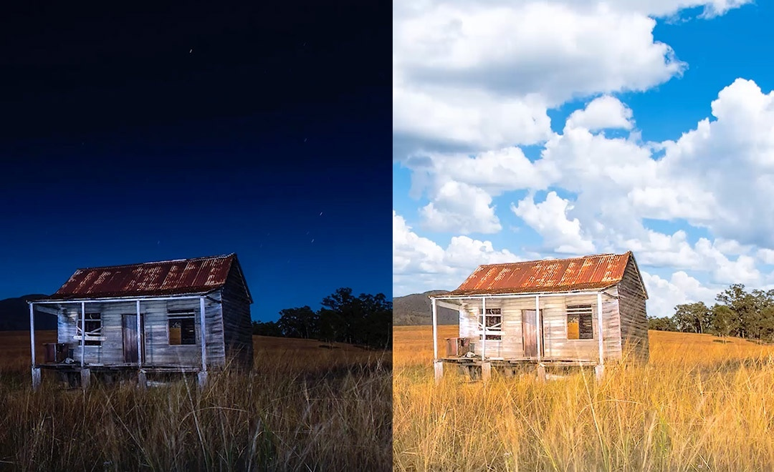

Slide 31
What is computer vision?
特征提取：从图像中提取各种复杂度的特征。例如：
线，边缘提取
局部化的特征点检测如边角检测，斑点检测
更复杂的特征可能与图像中的纹理形状或运动有关。

Slide 32
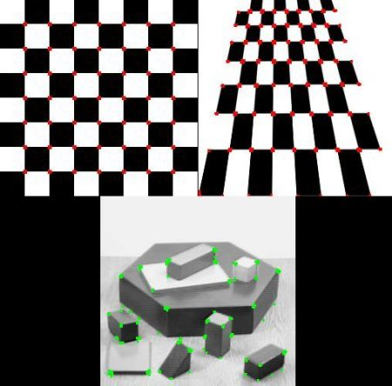
仿射不变性、尺度不变性

Slide 33
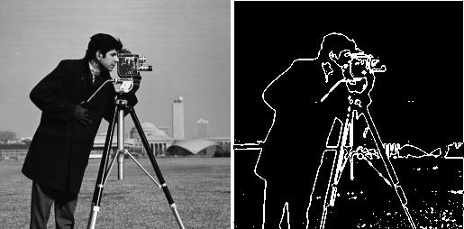

Slide 34
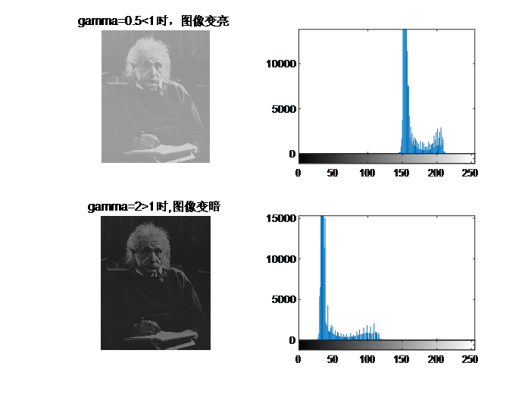

Slide 35
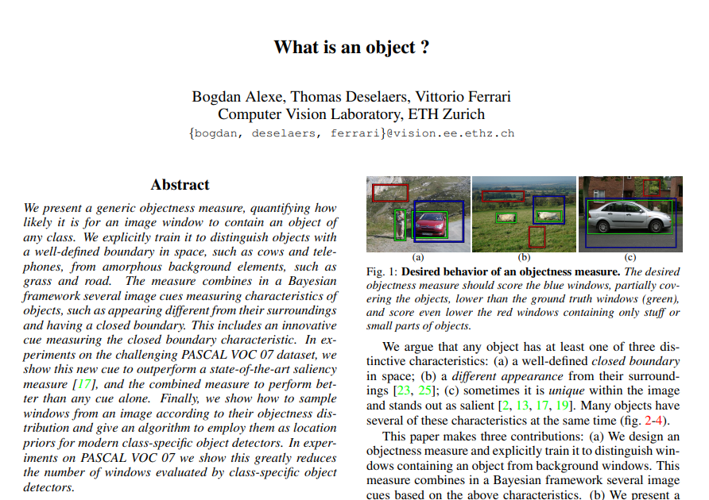
What is computer vision?
检测/分割：在图像处理过程中，有时会需要对图像进行分割来提取有价值的用于后继处理的部分，例如筛选特征点、分割一或多幅图片中含有特定目标的部分

Slide 36
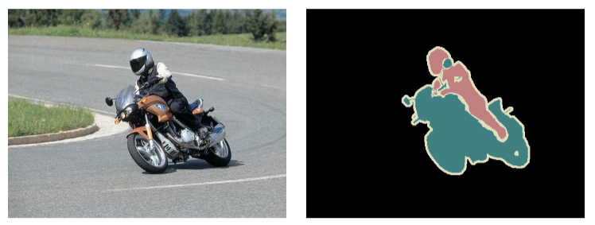

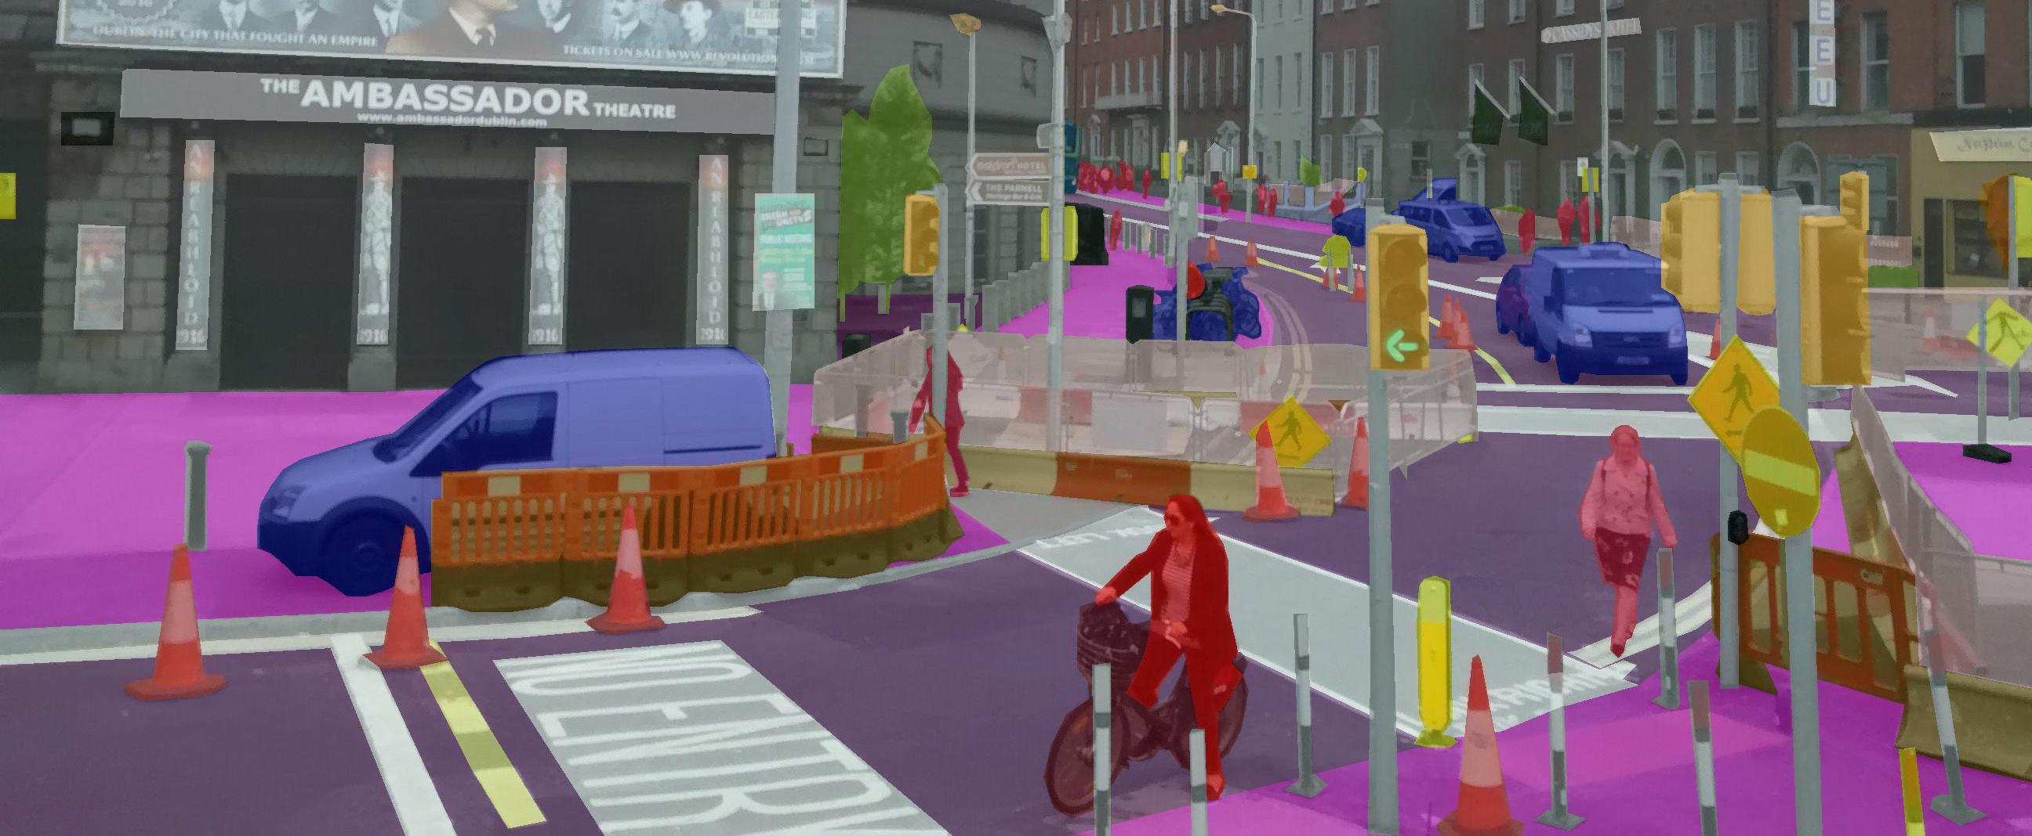

Slide 37
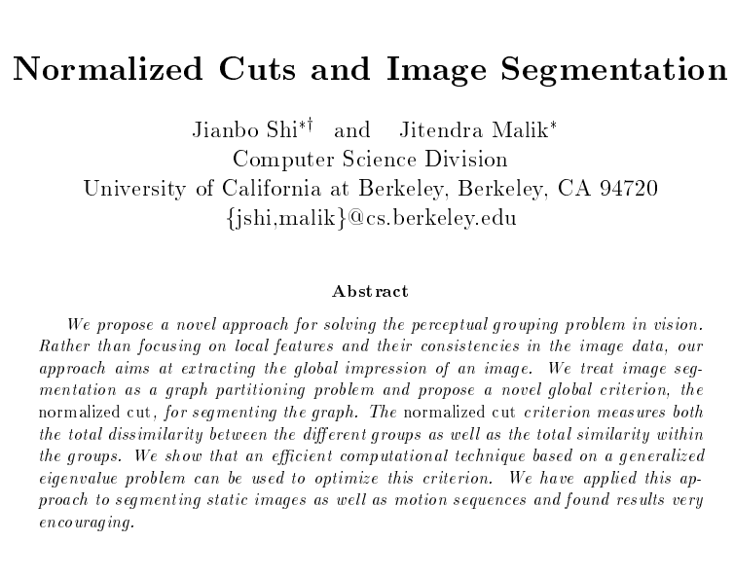
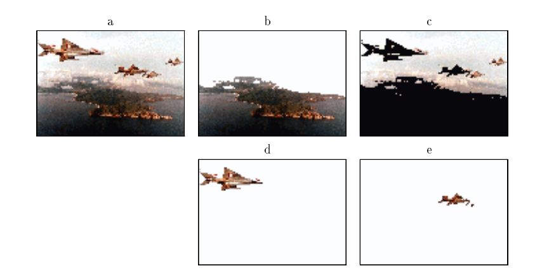

Slide 38
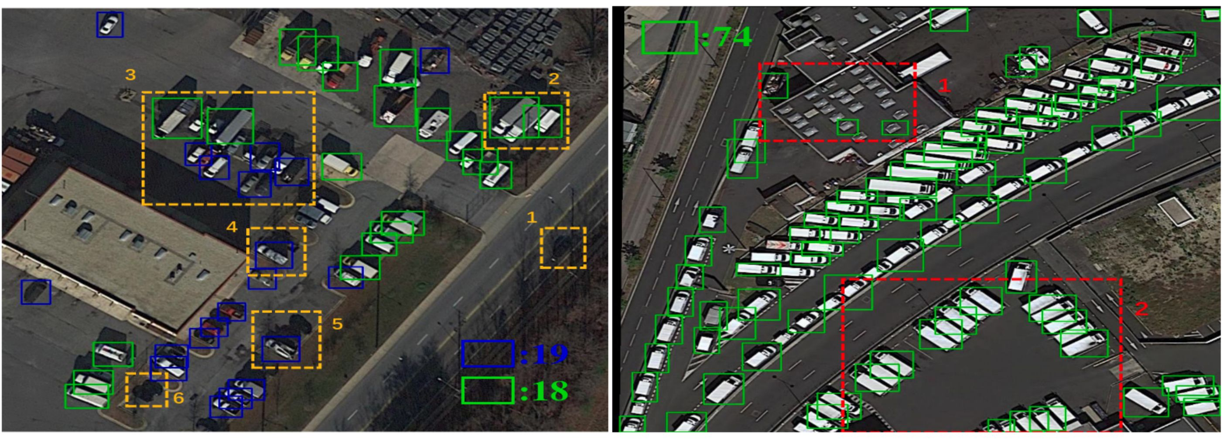
小目标监测

Slide 39
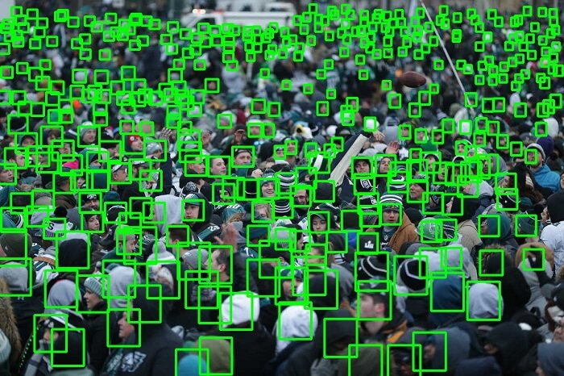
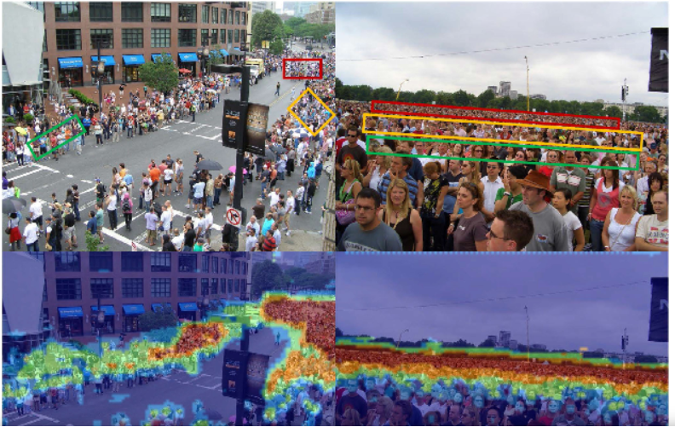
人群计数

Slide 40
What is computer vision?
高级分析：到了这一步，数据往往具有很小的数量，例如图像中经先前处理被认为含有目标物体的部分。这时的处理包括：验证得到的数据是否符合前提要求
估测特定系数，比如目标的姿态
目标跟踪
对目标进行分类

Slide 41
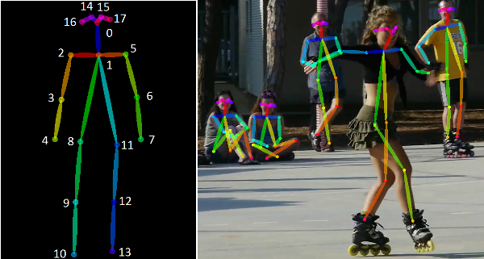
姿态估计，能做什么？
Notes:
智慧法律、智能监控

Slide 42
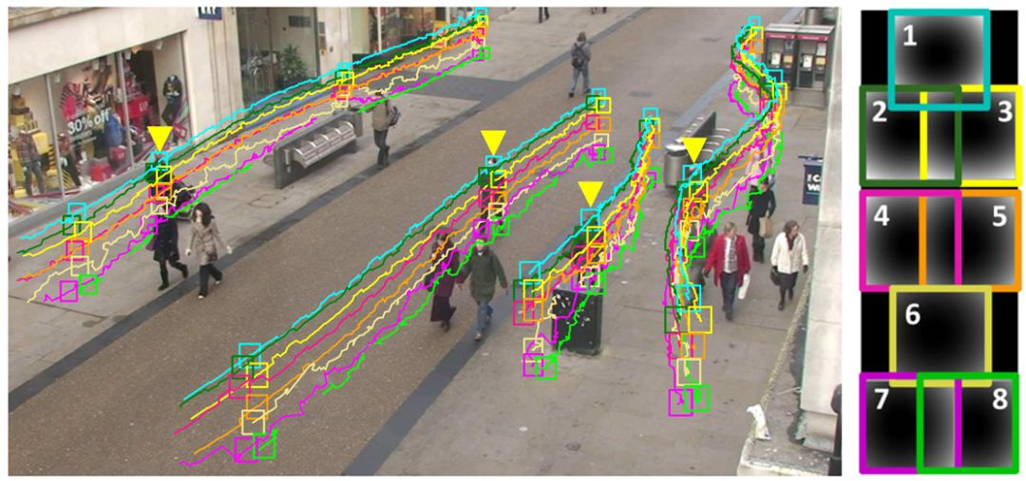
目标跟踪，能做什么？

Slide 43
计算机视觉可以做那些任务？

Slide 44
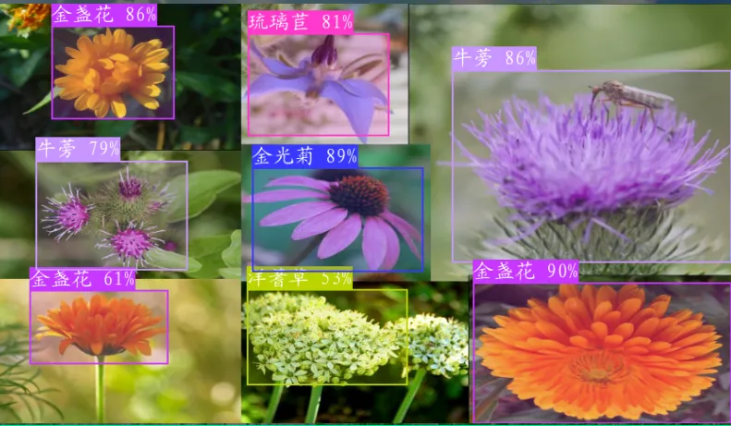
What can computer vision do?
Vision as a recognition system
基于深度学习的花卉检测与识别系统 https://developer.aliyun.com/article/1194458

Slide 45
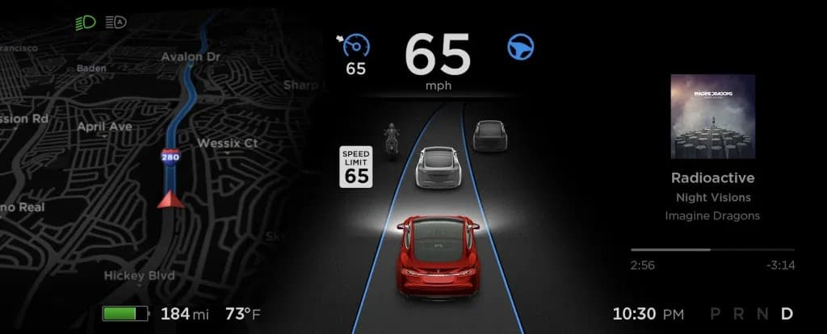
What can computer vision do?
Vision for Autopilot

Slide 46
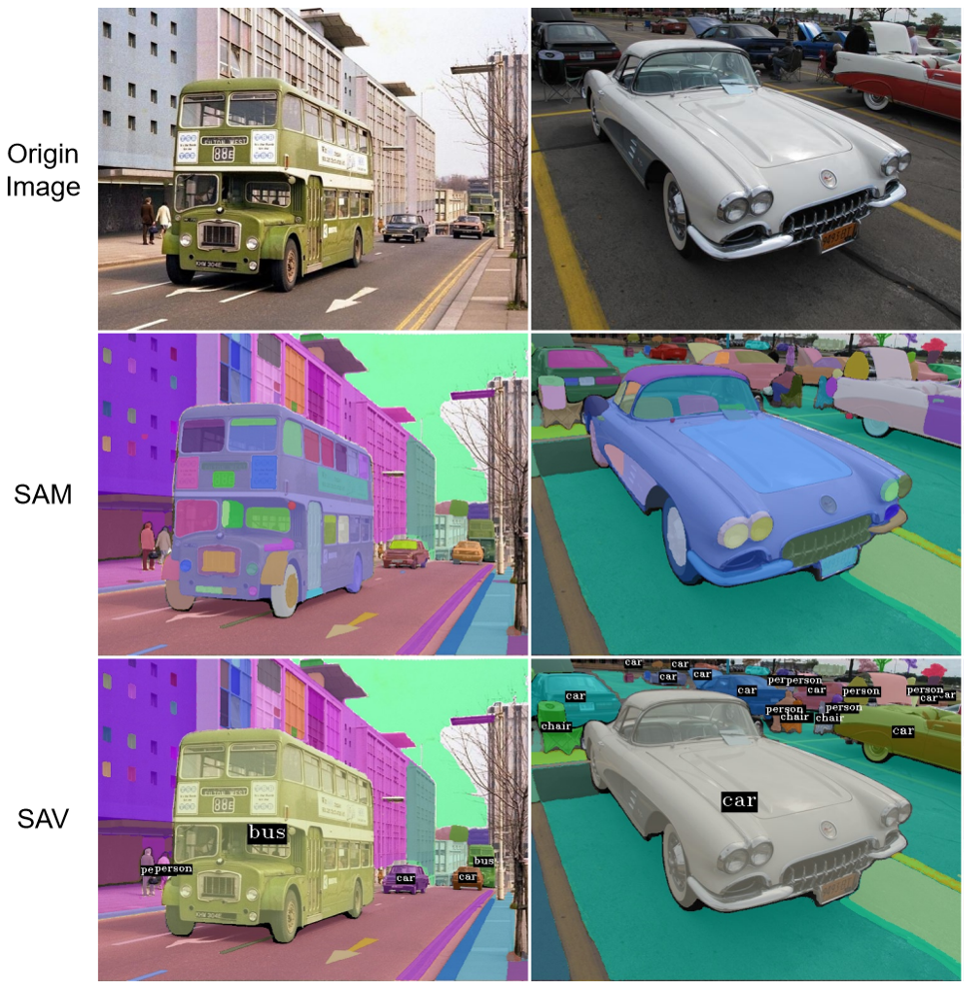
What can computer vision do?
Vision as a source of semantic information

Slide 47
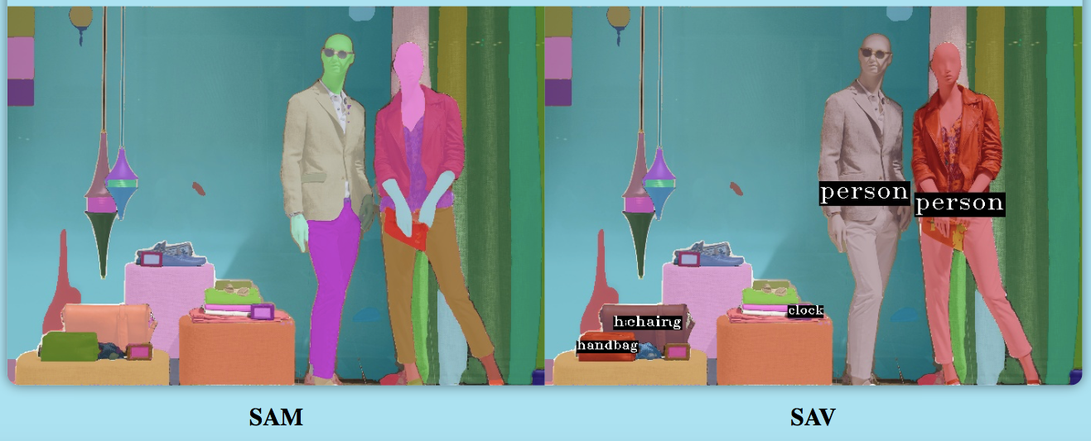
What can computer vision do?
Vision as a source of semantic information
[1] Kirillov A, Mintun E, Ravi N, et al. Segment anything[J]. arXiv preprint arXiv:2304.02643, 2023.
[2] Segment-Any-Video https://github.com/kadirnar/segment-anything-video

Slide 48
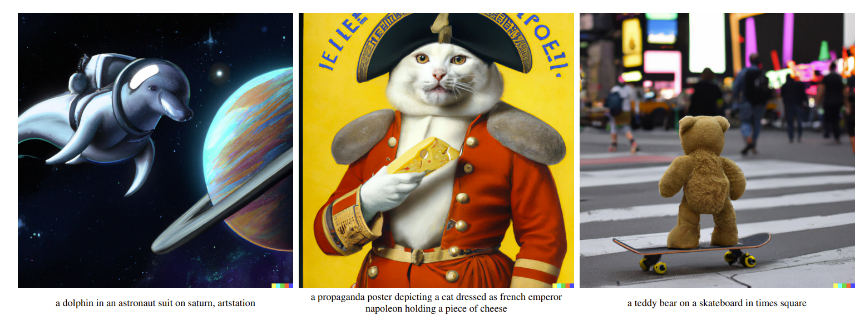
What can computer vision do?
Vision as art worker
无论从真实度还是文字细节的还原度都几乎无可挑剔
From openai DALL·E 2, released on Apr. 23, 2022

Slide 49
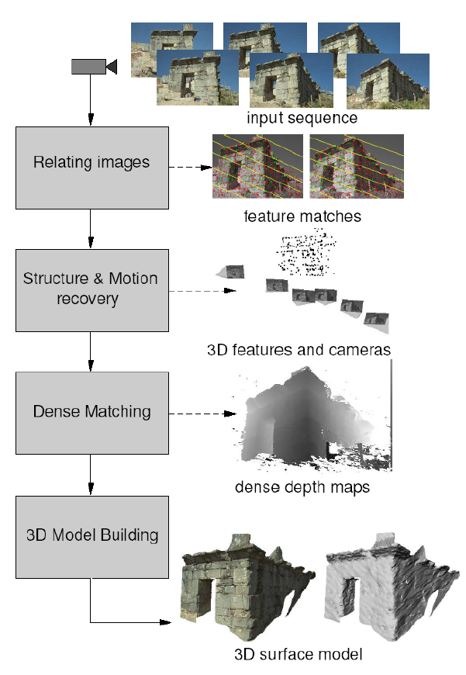
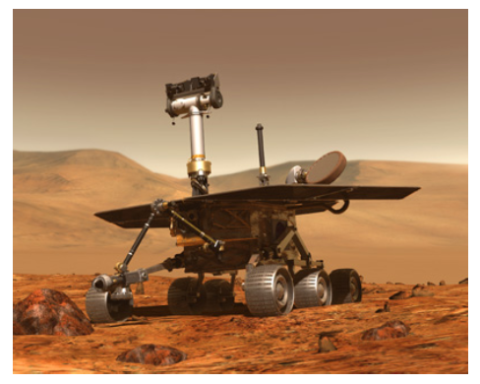
What can computer vision do?
Vision as measurement device

Slide 50
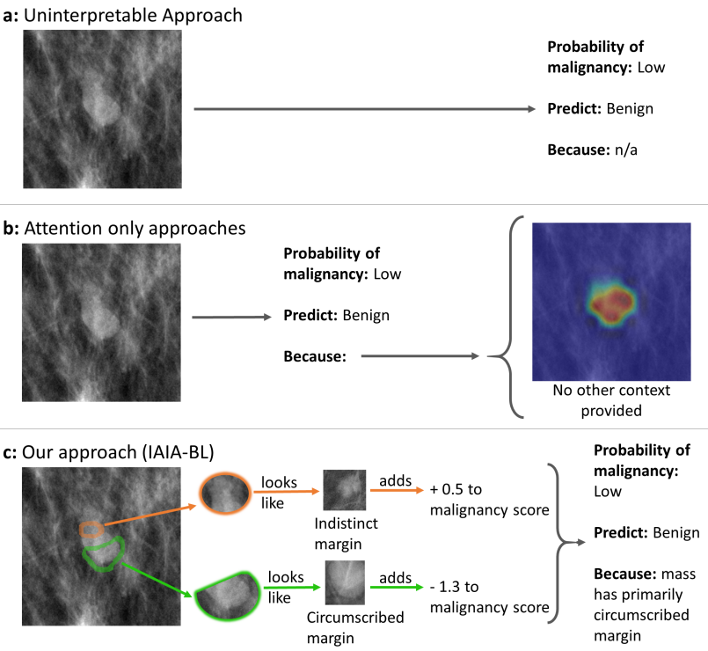
What can computer vision do?

Slide 51
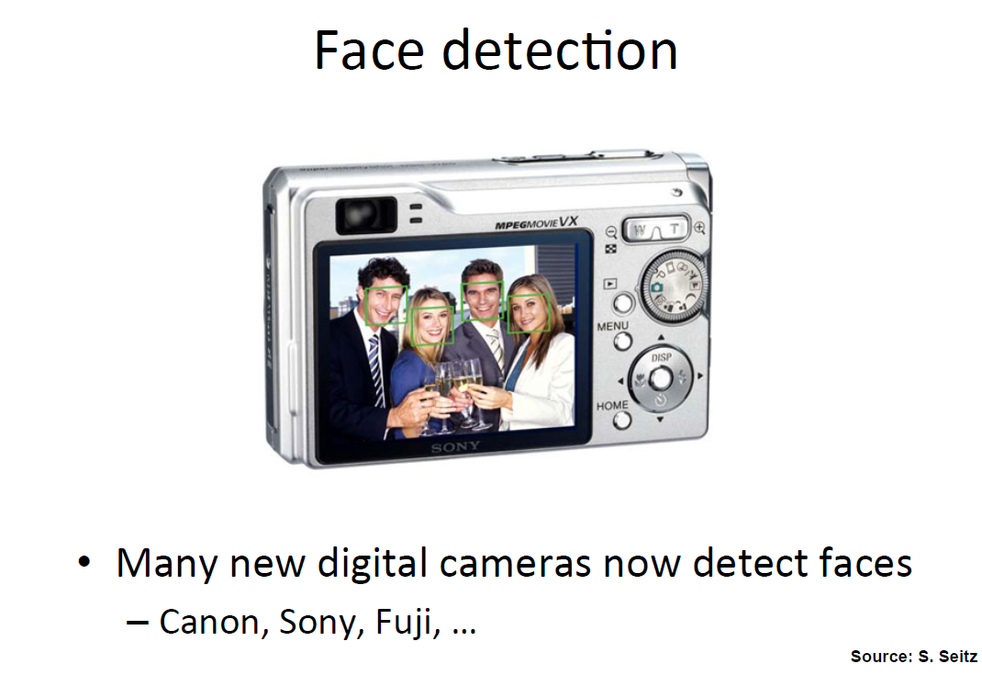
What can computer vision do?

Slide 52

What can computer vision do?

Slide 53

What can computer vision do?

Slide 54

What can computer vision do?

Slide 55

其他视觉技术

Slide 56
当前计算机视觉热点是什么？

Slide 57

当前计算机视觉热点
视觉生成(diffusion model)
3D场景/人体重建
多模态大语言模型

Slide 58
视觉生成(diffusion model) text-to-image
无论从真实度还是文字细节的还原度都几乎无可挑剔
From openai DALL·E 2, released on Apr. 23, 2022 https://openai.com/index/dall-e-2/

Slide 59

3D场景/人体重建 2D to 3D
3D World
Input image
From World Lab, Li Fei-Fei, 2024 https://www.worldlabs.ai/

Slide 60

多模态大语言模型
视觉感知任务
粗粒度任务
细粒度任务
文字识别任务
视觉认知任务
推理任务
MME: A Comprehensive Evaluation Benchmark for Multimodal Large Language Models

Slide 61
为什么计算机视觉存在挑战？

Slide 62

Why is computer vision difficult?

Slide 63

Why is computer vision difficult?

Slide 64



Why is computer vision difficult?

Slide 65

Why is computer vision difficult?
Semantic Gap (语义鸿沟)

Slide 66



视觉中的因果
2011 年图灵奖得主朱迪亚·珀尔（Judea Pearl）

Slide 67





视觉中的不确定性
数据不确定
模型不确定

Slide 68



视觉中的多模态数据融合
Multisensory Robot
Multisensory Autonomous Car
Fifty sensors feed into a computer to help maintain balance and direction as well as helping the robot recover in the event of a fall or being forced off its intended course.
https://www.edn.com/bigdog-robot-a-sensor-based-enhancement-of-human-capabilities/

Slide 69




视觉中的多模态数据融合
Multimodal Imaging (Human Brain/Kidney)
Acosta JN, Falcone GJ, Rajpurkar P, Topol EJ. Multimodal biomedical AI. Nat Med. 2022;10.1038/s41591-022-01981-2. doi:10.1038/s41591-022-01981-2

Slide 70
实验
Matlab或者python
图像去噪
图像超分辨
图像边缘检测
图像分割
人脸识别

Slide 71
Computer Vision and Pattern Recognition 计算机视觉与模式识别
Color
张长青
天津大学 智能与计算学部

Slide 72
What is color?
Color is a psychological property of our visual experiences when we look at objects and lights, not a physical property of those objects or lights (S. Palmer, Vision Science: Photons to Phenomenology)
Color is the result of interaction between physical light in the environment and our visual system（物理信号刺激生理系统）

Slide 73
http://www.photoaxe.com/wp-content/uploads/2007/04/camera-sensor.jpg
Notes:
Digital cameras are usually equipped with IR-blocking filters to prevent unnatural-looking images. IR-transmitting (passing) filters, or removal of factory IR-blocking filters, are commonly used in infrared photography to pass infrared light and block visible and ultraviolet light.

Slide 74
Visible Light
Plank’s law for Blackbody radiation 普朗克黑体辐射定律
Surface of the sun: ~5800K
Why do we see light of these wavelengths?
…because that’s where the
Sun radiates EM energy
© Stephen E. Palmer, 2002
Notes:
在任意温度T下，从一个黑体中发射出的电磁辐射的辐射率与频率彼此之间的关系。

Slide 75
The Physics of Light
Some examples of the spectra of light sources
A. 红宝石激光器
Rel. power
Rel. power
B. 磷化镓晶体
C. 钨灯泡
D. 日光
Rel. power
Rel. power

Slide 76








The Physics of Light
Some examples of the reflectance spectra of surfaces
Red
Yellow
Blue
Purple
% Light Reflected
400 700
400 700
400 700
400 700
Wavelength (nm)
© Stephen E. Palmer, 2002

Slide 77

Overview of Filtering
Gaussian filtering
Median filtering

Slide 78


Gaussian Kernel
0.003 0.013 0.022 0.013 0.003
0.013 0.059 0.097 0.059 0.013
0.022 0.097 0.159 0.097 0.022
0.013 0.059 0.097 0.059 0.013
0.003 0.013 0.022 0.013 0.003
5 x 5, σ = 1
Constant factor at front makes volume sum to 1 (can be ignored, as we should re-normalize weights to sum to 1 in any case)
Source: C. Rasmussen

Slide 79
Choosing kernel width
Gaussian filters have infinite support, but discrete filters use finite kernels
Source: K. Grauman

Slide 80

Choosing kernel width
Rule: set filter half-width to about 3 σ

Slide 81


Example: Smoothing with a Gaussian

Slide 82

Mean vs. Gaussian filtering

Slide 83
Gaussian filters
Remove “high-frequency” components from the image (low-pass filter) 为什么？
Convolution with self is another Gaussian
So can smooth with small-width kernel, repeat, and get same result as larger-width kernel would have
Convolving two times with Gaussian kernel of width σ is same as convolving once with kernel of width σ√2
Separable kernel
Factors into product of two 1D Gaussians
Notes:
总得来说，低频分量（低频信号）代表着图像中亮度或者灰度值变化缓慢的区域，也就是图像中大片平坦的区域，描述了图像的主要部分。。高频分量（高频信号）对应着图像变化剧烈的部分，也就是图像的边缘（轮廓）或者噪声以及细节部分。

Slide 84
Overview of Filtering
Gaussian filtering
Median filtering

Slide 85

Alternative idea: Median filtering
A median filter operates over a window by selecting the median intensity in the window
Is median filtering linear?
Source: K. Grauman
Notes:
Linearity of median filter: try filter([0 0 0; 0 1 0; 0 0 0] + [1 1 1; 1 1 2; 2 2 2])

Slide 86
Median filter
Replace each pixel by the median over N pixels (5 pixels, for these examples). Generalizes to “rank order” filters.
Median([1 7 1 5 1]) = 1
Mean([1 7 1 5 1]) = 2.8
In:
Out:
Spike noise is removed
5-pixel neighborhood
Monotonic edges remain unchanged
In:
Out:

Slide 87



Median filtering results
Best for salt and pepper noise
http://homepages.inf.ed.ac.uk/rbf/HIPR2/mean.htm#guidelines

Slide 88

Median vs. Gaussian filtering
3x3
5x5
7x7
Gaussian
Median

Slide 89

Median filtering results
Example of 3 median filters of varying radiuses applied to the same noisy photograph.

Slide 90

Edges
http://todayinart.com/files/2009/12/500x388xblind-contour-line-drawing.png.pagespeed.ic.DOli66Ckz1.png

Slide 91

Edge detection
Goal: Identify sudden changes (discontinuities) in an image
Intuitively, most semantic and shape information from the image can be encoded in the edges
More compact than pixels
Ideal: artist’s line drawing (but artist is also using object-level knowledge)
自底向上
自顶向下
Source: D. Lowe

Slide 92

Origin of edges
Edges are caused by a variety of factors:
surface normal discontinuity
depth discontinuity
surface color discontinuity
illumination discontinuity
Source: Steve Seitz

Slide 93







Image gradient
The gradient of an image:
The gradient points in the direction of most rapid increase in intensity
How does this direction relate to the direction of the edge?
The gradient direction is given by
The edge strength is given by the gradient magnitude
Source: Steve Seitz
Notes:
give definition of partial derivative: lim h->0 [f(x+h,y) – f(x,y)]/h

Slide 94
Differentiation and convolution
Recall, for 2D function, f(x,y):
We could approximate this as
(which is obviously a convolution)
-1 | 1

Slide 95

Finite difference filters
Other approximations of derivative filters exist:

Slide 96
Finite differences: example
Which one is the gradient in the x-direction (resp. y-direction)?

Slide 97




Effects of noise
Consider a single row or column of the image
Plotting intensity as a function of position gives a signal
Where is the edge?
Notes:
How to fix?

Slide 98
Effects of noise
Filters respond strongly to noise
Image noise results in pixels that look very different from their neighbors
Generally, the larger the noise the stronger the response
What is to be done?
Smoothing the image should help, by forcing pixels different from their neighbors (=noise pixels?) to look more like neighbors

Slide 99




Solution: smooth first
f
g
f * g
To find edges, look for peaks in

Slide 100

Derivative theorem of convolution
Differentiation is convolution, and convolution is associative:
This saves us one operation:
f

Slide 101


Derivative of Gaussian filter
x-direction
y-direction
Which one finds horizontal/vertical edges?

Slide 102



Scale of Gaussian derivative filter
1 pixel
3 pixels
7 pixels
Smoothed derivative removes noise, but blurs edge. Also finds edges at different “scales”.
Source: D. Forsyth

Slide 103

Implementation issues
The gradient magnitude is large along a thick “trail” or “ridge,” so how do we identify the actual edge points?
How do we link the edge points to form curves?
Notes:
Figures show gradient magnitude of zebra at two different scales

Slide 104
Designing an edge detector
Criteria for an “optimal” edge detector:
Good detection: the optimal detector must minimize the probability of false positives (detecting spurious edges caused by noise), as well as that of false negatives (missing real edges)
Good localization: the edges detected must be as close as possible to the true edges
Single response: the detector must return one point only for each true edge point; that is, minimize the number of local maxima around the true edge

Slide 105
Canny edge detector
This is probably the most widely used edge detector in computer vision
Theoretical model: step-edges corrupted by additive Gaussian noise
Canny has shown that the first derivative of the Gaussian closely approximates the operator that optimizes the product of signal-to-noise ratio and localization
MATLAB: edge(image, ‘canny’)
J. Canny, A Computational Approach To Edge Detection, IEEE Trans. Pattern Analysis and Machine Intelligence, 8:679-714, 1986.

Slide 106
Canny edge detector
Filter image with derivative of Gaussian
Find magnitude and orientation of gradient
Non-maximum suppression:
Thin multi-pixel wide “ridges” down to single pixel width

Slide 107


Non-maximum suppression
At q, we have a maximum if the value is larger than those at both p and at r. Interpolate to get these values.
Source: D. Forsyth

Slide 108

Example
original image (Lena)

Slide 109

Example
norm of the gradient

Slide 110

Example
thresholding

Slide 111

Example
Non-maximum suppression

Slide 112
Canny edge detector
Filter image with derivative of Gaussian
Find magnitude and orientation of gradient
Non-maximum suppression
Thin multi-pixel wide “ridges” down to single pixel width
Linking of edge points
Source: D. Lowe, L. Fei-Fei

Slide 113
Edge linking
Assume the marked point is an edge point. Then we construct the tangent to the edge curve (which is normal to the gradient at that point) and use this to predict the next points (here either r or s).
Source: D. Forsyth

Slide 114
Canny edge detector
Filter image with derivative of Gaussian
Find magnitude and orientation of gradient
Non-maximum suppression
Thin multi-pixel wide “ridges” down to single pixel width
Linking of edge points
Hysteresis thresholding: use a higher threshold to start edge curves and a lower threshold to continue them

Slide 115
Hysteresis thresholding
Use a high threshold to start edge curves and a low threshold to continue them
Reduces drop-outs

Slide 116
Hysteresis thresholding
original image
high threshold
(strong edges)
low threshold
(weak edges)
hysteresis threshold

Slide 117





Effect of σ (Gaussian kernel spread/size)
original
Canny with
Canny with
The choice of σ depends on desired behavior
large σ detects large scale edges
small σ detects fine features

Slide 118






Edge detection is just the beginning…
image
human segmentation
gradient magnitude
Berkeley segmentation database: http://www.eecs.berkeley.edu/Research/Projects/CS/vision/grouping/segbench/

Slide 119
课程信息
1. 计算机视觉导论（2学时）
2. 机器学习与模式识别基础 （2学时）
3. 底层视觉（分割、边缘检测）（2学时）
4. 特征提取（SIFT/BoW等）（2学时）
5. 图像分类基础（2学时）
6. 多模态模式识别（2学时）
7. 高级主题 （4个学时）

Slide 120
基础实验1
1. 熟悉python语言及对图像的基本操作
2. 提取图像3个通道信息（red，green，blue），并将图像显示出来；
3. 图像分割基础：
（a）将亮度>某阈值的划分为前景，其余为背景
（b）使用k-means聚类方法对图像进行分割
计算机视觉顶级论文：https://openaccess.thecvf.com/menu
计算机视觉基础视频：
https://fpcv.cs.columbia.edu/

